Slide 1
Python Basics
Muttineni Sai Rohith
Tata Consultancy Services

Slide 2
Contents to be covered:
Python Overview
Python Basic Syntax
Python Variables
Python Basic Data Types: Numbers, Strings
Python Lists, Tuples and Dictionary
Python Conditional Loops
Python Functions

Slide 3
Python Overview:
Python is a high-level programming language which is:
Interpreted: Python is processed at runtime by the interpreter.
Interactive: You can use a Python prompt and interact with the interpreter directly to write your programs.
Object-Oriented: Python supports Object-Oriented technique of programming.
Beginner’s Language: Python is a great language for the beginner-level programmers and supports the development of a wide range of applications.

Slide 4
Python Features:
Portable: It can run on various hardware platforms and has the same interface on all platforms.
Extendable: You can add low-level modules to the Python interpreter.
Scalable: Python provides a good structure and support for large programs.
Python has support for an interactive mode of testing and debugging.
Python has a broad standard library cross-platform.

Slide 5
Everything in Python is an Object: variables, functions, even code. Every object has an ID, a type, and a value.
Python provides interfaces to all major commercial databases.
Python supports functional and structured programming methods as well as OOP.
Python provides very high-level dynamic data types and supports dynamic type checking.
Python supports GUI applications.
Python supports automatic garbage collection.
Python can be easily integrated with C, C++, and Java.

Slide 6
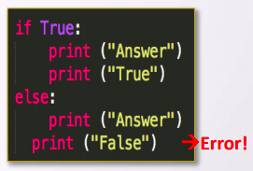
Basic Syntax:
Indentation is used in Python to delimit blocks. The number of spaces is variable, but all statements within the same block must be indented the same amount.
The header line for compound statements, such as if, while, def, and class should be terminated with a colon ( : )
The semicolon ( ; ) is optional at the end of statement.
Printing to the Screen: ( print(“Hello world”) )
Reading Keyboard Input:
name = input(“Enter your name”)
Python Comments: Single Comments ( # python single comment)
Multiple comments (‘’’ This is a
Multi line comment ‘’’)

Slide 7
Variables
No need to Declare
counter = 100 // integer assignment
miles = 100.0 // float
Name = “john” // String
z = none // A null value
flag = True // boolean value
a = b = c = 1 // Simultaneous assignment
x = 1
x = “aaa” // multiple assignment

Slide 8
Numbers:
Numbers are Immutable objects in Python that cannot change their values.
There are three built-in data types for numbers in Python 3:
Integer (int)
Floating-point numbers (float)
Complex numbers: + j

Slide 9
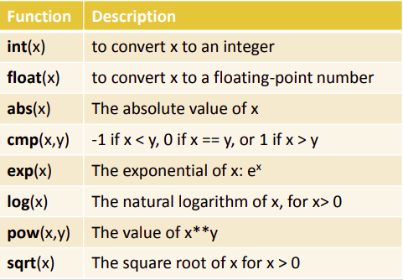
Common Number Functions:

Slide 10
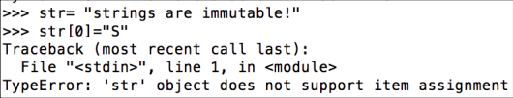


Python Strings:
Python Strings are Immutable objects that cannot change their values.
You can update an existing string by (re)assigning a variable to another string.
Python accepts single ('), double (") and triple (''' or """) quotes to denote string literals.
String indexes starting at 0 in the beginning of the string and working their way from -1 at the end.

Slide 11
Python Lists:
A list in Python is an ordered group of items or elements, and these list elements don't have to be of the same type.
Python Lists are mutable objects that can change their values.
A list contains items separated by commas and enclosed within square brackets.
List indexes like strings starting at 0 in the beginning of the list and working their way from -1 at the end.
Similar to strings, Lists operations include slicing ([ ] and [:]) , concatenation (+), repetition (*), and membership (in).

Slide 12
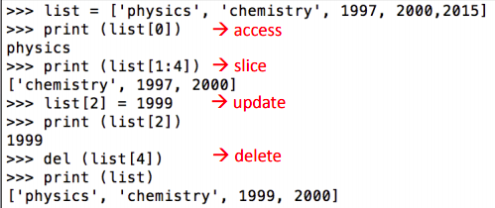
This example shows how to access, update and delete list elements:

Slide 13
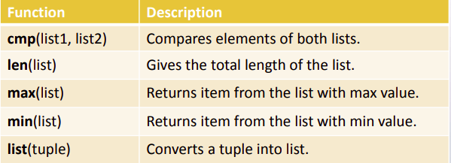
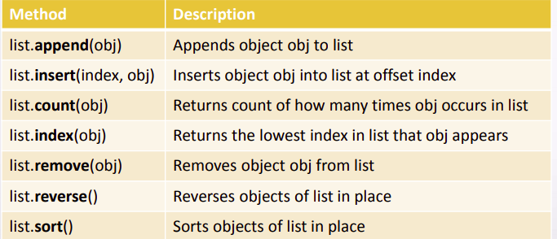
Common List Functions:

Slide 14
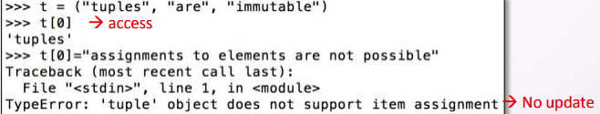
Python Tuples:
Python Tuples are Immutable objects that cannot be changed once they have been created.
A tuple contains items separated by commas and enclosed in parentheses instead of square brackets.

Slide 15
You can update an existing tuple by (re)assigning a variable to another tuple.
Tuples are faster than lists and protect your data against accidental changes to these data.
The rules for tuple indices are the same as for lists and they have the same operations, functions as well.
To write a tuple containing a single value, you have to include a comma, even though there is only one value. e.g. t = (3, )

Slide 16
Python Dictionary:
Python's dictionaries are kind of hash table type which consist of key-value pairs of unordered elements.
Keys : must be immutable data types ,usually numbers or strings.
Values : can be any arbitrary Python object.
Python Dictionaries are mutable objects that can change their values.
A dictionary is enclosed by curly braces ({ }), the items are separated by commas, and each key is separated from its value by a colon (:).
Dictionary’s values can be assigned and accessed using square braces ([]) with a key to obtain its value.

Slide 17
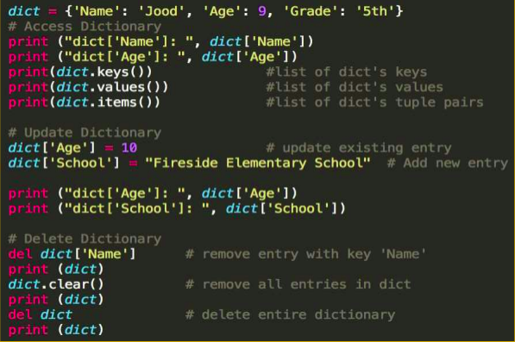
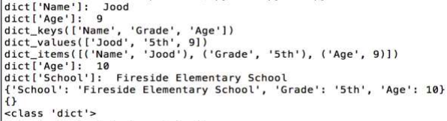
Example:

Slide 18
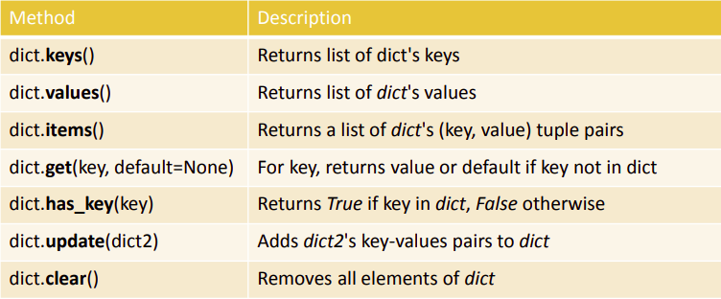
Common Fuctions:

Slide 19
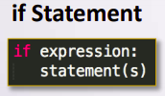
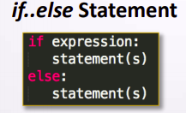
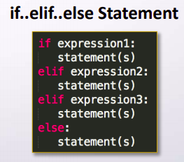
Conditionals:
In Python, True and False are Boolean objects of class 'bool' and they are immutable.
Python assumes any non-zero and non-null values as True, otherwise it is False value.
Python does not provide switch or case statements as in other languages.

Slide 20
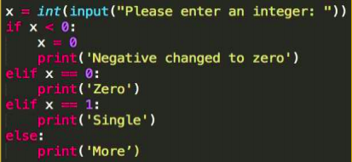
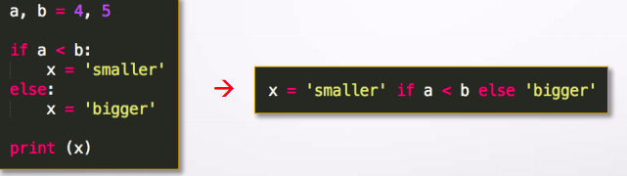
Example:
Conditional Expression:

Slide 21
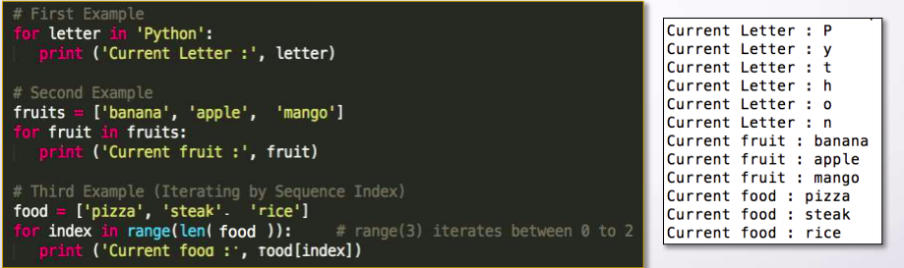
Python Loops:
The For Loop:

Slide 22


While Loop: Break Statement: Terminates the loop statement and transfers execution to the statement immediately following the loop.

Slide 23

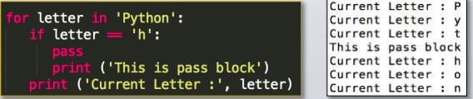
Continue:
Causes the loop to skip the remainder of its body and immediately retest its condition prior to reiterating.
pass :
Used when a statement is required syntactically but you do not want any command or code to execute.

Slide 24

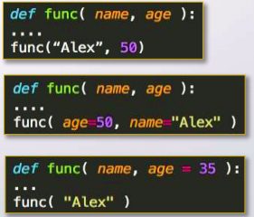
Python Functions:
Function Arguments:
You can call a function by using any of the following types of arguments:
• Required arguments: the arguments passed to the function in correct positional order.
• Keyword arguments: the function call identifies the arguments by the parameter names.
• Default arguments: the argument has a default value in the function declaration used when the value is not provided in the function call.

Slide 25
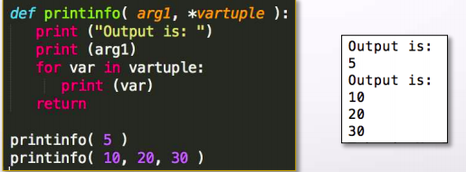
Variable-length arguments: This used when you need to process unspecified additional arguments. An asterisk (*) is placed before the variable name in the function declaration.

Slide 26
Thank You
These are just basics, Learn, implement and explore more about python for complete Understanding.

